Slide 1
CHAPTER 5
OPTIONS AND APPLICATIONS

Slide 2
Outline (a)
Mechanics of options markets
1. Definition of options
2. Option positions
3. Underlying assets
4. Margins
5. Some special options
6. Terminology
II. Properties of Stock options
1. Factors affecting option prices
2. Upper and lower bounds for option prices
3. Put-Call Parity
4. American Options

Slide 3
Outline (b)
III. Trading strategies involving options
1. Strategies involving a single option and a stock
2. Spreads
3. Combinations

Slide 4
Options
A call option is an option to buy a certain asset (underlying asset) by a certain date (expiration date or maturity) for a certain price (the strike price or exercise price)
A put option is an option to sell a certain asset (underlying asset) by a certain date (expiration date or maturity) for a certain price (the strike price or exercise price)

Slide 5
Options vs Futures/Forwards
A futures/forward contract gives the holder the obligation to buy or sell at a certain price
An option gives the holder the right to buy or sell at a certain price

Slide 6
American vs European Options
An American option can be exercised at any time during its life
A European option can be exercised only at maturity

Slide 7
Option Positions
Long call
Long put
Short call
Short put

Slide 8
Long Call
Profit from buying one European call option: option price = $5, strike price = $100. Long Call= Max(ST-100-5,-5)
30
Profit ($)
20
10
Terminal
stock price ($)
70
80
90
100
0
-5
110
120
130

Slide 9
Short Call
Profit from writing one European call option: option price = $5, strike price = $100 Short call= Min(100-ST+5; 5)
Profit ($)
5
110
120
130
0
70
80
90
100
Terminal
stock price ($)
-10
-20
-30

Slide 10
Long Put
Profit from buying a European put option: option price = $7, strike price = $70 Long Put= Max(70-ST-7; -7)
30
Profit ($)
20
10
Terminal
stock price ($)
0
40
50
60
70
80
90
100
-7

Slide 11
Short Put
Profit from writing a European put option: option price = $7, strike price = $70 Short put= Min(ST-70+7; 7)
Profit ($)
Terminal
stock price ($)
7
40
50
60
0
70
80
90
100
-10
-20
-30

Slide 12
Payoff from a European long call at T
max (S_{T} - K, 0)
Payoff from a European short call at T:
-max (S_{T} - K, 0)= min (K-S_{T},0)
Payoff from a European long put at T :
max(K-S_{T},0)
Payoff from a European short put at T :
-max(K-S_{T},0)= min (S_{T} - K, 0)

Slide 13
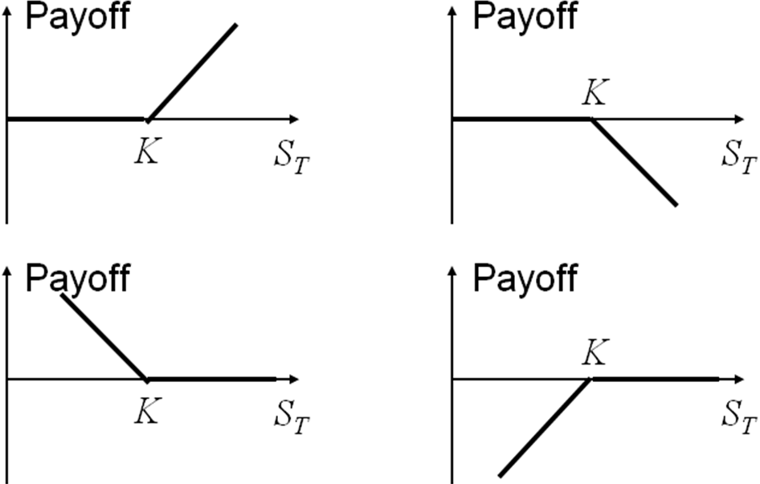
Payoff from the four positions at T

Slide 14
Underlying assets
Stocks
Currencies
Stock indices
Futures

Slide 15
Margins
A trader who writes options (short position) is required to maintain funds in a margin account.

Slide 17
Specification of stock options
Expiration Dates: The precise expiration date is the third Friday of the expiration month and trading takes place every business day (8:30 a.m. to 3:00 p.m., Chicago time) until the expiration date.

Slide 18
Dividends and Stock Splits
The early over-the-counter options were dividend protected. If a company declared a cash dividend, the strike price for options on the company’s stock was reduced on the ex-dividend day by the amount of the dividend. Exchange-traded options are not usually adjusted for cash dividends. In other words, when a cash dividend occurs, there are no adjustments to the terms of the option contract. An exception is sometimes made for large cash dividends.
Exchange-traded options are adjusted for stock splits. A stock split occurs when the existing shares are. For example, in a 3-for-1 stock split, three new shares are issued to replace each existing share. All else being equal, the 3-for-1 stock split should cause the stock price to go down to one-third of its previous value ‘‘split’’ into more shares. The terms of option contracts are adjusted to reflect expected changes in a stock price arising from a stock split. The positions of both the writer and the purchaser of a contract remain unchanged.

Slide 19
Some special options
Warrants
Employee stock option
Convertible bond= option-embedded bond

Slide 20
Warrants
Warrants are options issued by a financial institution or nonfinancial corporation. The common use of warrants by a nonfinancial corporation is at the time of a bond issue to make the bond more attractive to investors.
When call warrants are issued by a corporation on its own stock, exercise will usually lead to new treasury stock being issued
Notes:
.

Slide 21
Executive Stock Options
Executive stock options are a form of remuneration issued by a company to its executives
They are usually at the money when issued
When options are exercised the company issues more stock and sells it to the option holder for the strike price

Slide 22
Convertible Bonds
Convertible bonds are regular bonds that can be exchanged for equity at certain times in the future according to a predetermined exchange ratio
Very often a convertible is callable
The call provision is a way in which the issuer can force conversion at a time earlier than the holder might otherwise choose

Slide 23
Terminology (a)
At-the-money- option : when S=K.
In-the-money- option : when S> K (call option) or S< K (put option)
Out- of-the-money- option: when S< K (call option) or S> K (put option)

Slide 24
Terminology (b)
Intrinsic value : is the maximum of zero and the value the option would have if it were exercised immediately.
Intrinsic value of a call option = max(S0-K,0)
Intrinsic value of a put option= max(K-S0,0)
Time value : An in-the-money American option must be worth at least as much as its intrinsic value because the holder can realize the intrinsic value by exercising immediately. → The time value of an option depends on the time length to maturity.

Slide 25
Notation
c : European call option price - giá quyền chọn mua kiểu Âu
p : European put option price - giá quyền chọn bán kiểu Âu
S₀ : Stock price today - giá cổ phiếu
K : Strike price - giá thực hiện
T : Life of option - Kỳ hạn quyền chọn
s: Volatility of stock price - biến động giá cổ phiếu
C : American Call option price - Giá quyền chọn mua kiểu Mỹ
P : American Put option price - Giá quyền chọn bán kiểu Mỹ
S_{T} :Stock price at option maturity - Giá cổ phiếu vào thời điểm đáo hạn
D : Present value of dividends during option’s life - Giá trị hiện tại của cổ tức
r : Risk-free rate for maturity T with cont comp - Lãi suất phi rủi ro (liên tục)

Slide 26
Assumptions
No transaction costs
All trading profits are subject to the same tax rate.
Borrowing and lending are possible at the risk-free interest rate.

Slide 27
Effect of Variables on Option Pricing
Variable
c
p
C
P
+
–
+
–
S₀
–
+
–
+
K
?
?
+
+
T
+
+
+
+
σ
+
–
+
–
r
–
+
–
+
D

Slide 28
Explanations (a)
S and K
Call option: pay-off = S – K → Call options become more valuable as the stock price increases and less valuable as the strike price increases.
Put option: pay-off = K-S → Put options become more valuable as the strike price increases and less valuable as the stock price increases.
Time to expiration
American options become more valuable as the time to expiration increases.
European options usually become more valuable as the time to expiration increases, but this is not always the case.

Slide 29
Explanations (b)
Volatility
- As volatility increases, the chance that the stock will do very well or very poorly increases. The owner of a call (a put) benefits from price increases (decreases) but has limited downside risk in the event of price decreases (increases) → The values of both calls and puts increase as volatility increases.
Risk-free interest rate
Interest rate increases → the expected return required by investors from the stock increases→ The PV of any future cash flows received by the holder of the option decreases→ PV of K decreases→ The value of a call increases and the value of a put decreases.
Future dividends
- The value of a call option is negatively related to the size of an anticipated future dividend and the value of a put option is positively related to the size of an anticipated future dividend.

Slide 30
American vs European Options
An American option is worth at least as much as the corresponding European option
C ≥ c
P ≥ p

Slide 31
Upper bounds for option prices (a)
Call options: the call option can not be worth more than the stock:
If c > S0 or C > S0, an arbitrageur can make a riskless profit by buying the stock and selling the call option.

Slide 32
Upper bounds for option prices (b)
Put options: the put option can not be worth more than K.
For European options, at maturity, the option can not be worth more than K. → It can not be worth more than the PV of K :
If P > K, or p > K or , an arbitrageur can make a riskless profit by writing the put option and investing the proceeds of the sale at the risk-free interest rate.

Slide 33
Lower bounds for Calls on Non-dividend-paying stocks (D = 0) (a)
Example : Suppose that
c = 3 S₀ = 20
T = 1 r = 10%
K = 18 D = 0
Is there an arbitrage opportunity?

Slide 34
Lower bounds for Calls on Non-dividend-paying stocks (D = 0) (d)
If an arbitrageur can make a riskless profit by one of the two following methods.
Course 1:
- Short the stock
- Buy the call
- Invest the balance in the risk-free asset.

Slide 35
Lower bounds for Calls on Non-dividend-paying stocks (D = 0) (e)
Portfolio A : one European call option plus an amount of cash equal to
Portfolio B : one share
The value of portfolio A at time T: max (S_{T}-K,0) + K = max (S_{T}, K)
The value of portfolio B at time T: S_{T}
Portfolio A is always worth as much as, can sometimes be worth more than portfolio B at time T. Thus, today

Slide 36
Lower bounds for Calls on Non-dividend-paying stocks (D = 0) (f)
If
Course 2:
Short portfolio B and long portfolio A.
+ Short a share
+ Long a call
+ Invest an amount of in the risk-free asset.

Slide 37
c can not be negative, thus

Slide 38
Ex: Consider a European call option on a non-dividend-paying stock when S0=$51, K = $50, T =0.5 year, r =0.12. What is the lower bound for the price of this option?

Slide 39
Lower bounds for Puts on Non-dividend-paying stocks (D = 0) (a)
Ex : Consider a European put opstion on a non-divivend paying stock: S₀=$37, K=$40, r=0.05 per annum, T=0.5 year, p = $1. Is there an arbitrage opportunity?
Action now, time 0 :
- Borrow $38 for 6 months
- Buy a share
- Buy a put
Net cash flows = 0

Slide 40
Lower bounds for Puts on Non-dividend-paying stocks (D = 0) (b)
If : an arbitrageur can make a riskless profit by:
Course 1:
Borrow (S₀ +p)
Buy a share and a put

Slide 41
Lower bounds for Puts on Non-dividend-paying stocks (D = 0) (c)
Portfolio C: one European put option plus one share
- Portfolio D : an amount of cash equal to
- The value of portfolio C : max (S_{T},K)
- The value of portfolio D: K
→ Portfolio C is always worth as much as, can sometimes be worth more than portfolio D at time T. Thus, at time 0

Slide 42
If : an arbitrageur can make a riskless profit by:
→ Course 2: Long portfolio C and short portfolio D, or:
Buy a share and a put option
Borrow an amount of

Slide 43
Lower bounds for Puts on Non-dividend-paying stocks (D = 0) (d)

Slide 44
Problems
1.What is a lower bound for the price of a 4-month call option on a non-dividend paying stock when the stock price is $28, the strike price is $25, the risk-free interest rate is 8% per annum?
S0 – Ke^(-rT)=28 – 25xe^(-8%x4/12)=3.66
2. What is a lower bound for the price of a 1-month European put option on a non-dividend-paying stock when the stock price is $12, the strike price is $15, the risk-free interest rate is 6% per annum ?
Ke^(-rT) – S0=15xe^(-6%x1/12) – 12= 2.93

Slide 45
3. What is a lower bound for the price of a 2-month European put option on a non-dividend paying stock when the stock price is $58, the strike price is $65, the risk-free rate is 5% per annum?
Ke^(-rT) – S0=65xe^(-5%x2/12) – 58= 6.46
4. What is a lower bound for the price of a 6-month European call option on a non-dividend paying stock when the stock price is $80, the strike price is $75, the risk-free rate is 10% per annum?
S0 – Ke^(-rT)=80 – 75xe^(-10%x6/12)=8.66
5. A 1-month European put option on a non-dividend paying stock is currently selling for $2.5. The stock price is $47, the strike price is $50, the risk-free rate is 6% per annum. Is there an arbitrage opportunity?

Slide 46
Put-Call Parity
Portfolio A : one European call option + an amount of cash equal to
FV: Max(ST-K, 0) +K= Max(ST,K)
Portfolio C : one European put option + one share
FV= Max(K-ST,0) +ST= Max(K,ST)
The values of both A and C at time T are max (S_{T},K) → They must have identical values today:
The value of a European call with a certain strike price and exercise date can be deducted from the value of a European put with the same strike price and exercise date, and vice versa.

Slide 47
Ex : A European call and a European put have the same strike price and exercise date, and:
S₀=31, K=30, r=0.01 per annum, T = 3 months, c =3
How do you make a riskless profit when p =2.25? when p=1?

Slide 48
Put-Call Parity- American options

Slide 49
Put-Call Parity- Effect of dividends
European options:
American options

Slide 50
Problems
6. The price of a non-dividend-paying stock is $19 and the price of a 3-month European call option on the stock with a strike price of $20 is $1. The risk-free rate is 4% per annum. What is the price of a 3-month European put option with a strike price of $20?

Slide 51
7. A European call option and put option on a stock both have a strike price of $20 and an expiration date in 3 months. Both sell for $3. The risk-free interest rate is 10% per annum, the current stock price is $19 and a $1 dividend is expected in 1 month. Identify the arbitrage opportunity open to a trader.

Slide 52
American options
Put-Call Parity:

Slide 53
American Call Options – Early exercise
Ex: Consider an American call option on a non-dividend-paying stock with 1 month to expiration when the stock price is $50 and the strike price is $40. The option is deep in the money. The option’s intrinsic value is $10. Should you exercise the call immediately?

Slide 54
Course 1: Buy the stock by exercising the call (K= $40) and hold it in one month.
Course 2: Keep the option and exercise it at the end of the month. The $40 strike price is paid out 1 month later than it would be if the option were exercised immediately, so that interest is earned on the $40 for 1 month.
If you think the stock is overpriced and you are wondering whether the exercise the option and sell the stock :
Sell the call for more than $10.
Or keep the option and short the stock to lock in a better profit than $10.

Slide 55
A formal argument
A European call:
An American call:
Thus:

Slide 56
The price of an American or European call option and the stock price

Slide 58
American put options – Early exercise
Ex : Consider an American put option with K=$10, the stock price is virtually zero. Should you exercise the put immediately?
If you exercise immediately?
If you keep the put and exercise at maturity?
→ You should exercise immediately if the put is sufficiently deep in the money.

Slide 59
A formal argument
A European put:
An American put:

Slide 60
Variation of price of an American put option with stock price

Slide 62
III. Trading Strategies involving options
1. Strategies involving a single option and a stock
2. Spreads
2.1. Bull Spreads
2.2. Bear Speads
2.3. Butterfly Spreads
3. Combinations
3.1. Straddle
3.2. Strips & Straps
3.3 Strangles

Slide 63
Strategies involving a single option and a stock (a)
Short Call + Long Stock → ‘covered call’.
Long Call + Short Stock
Long Put + Long Stock → ‘protective put’.
Short Put + Short Stock

Slide 64
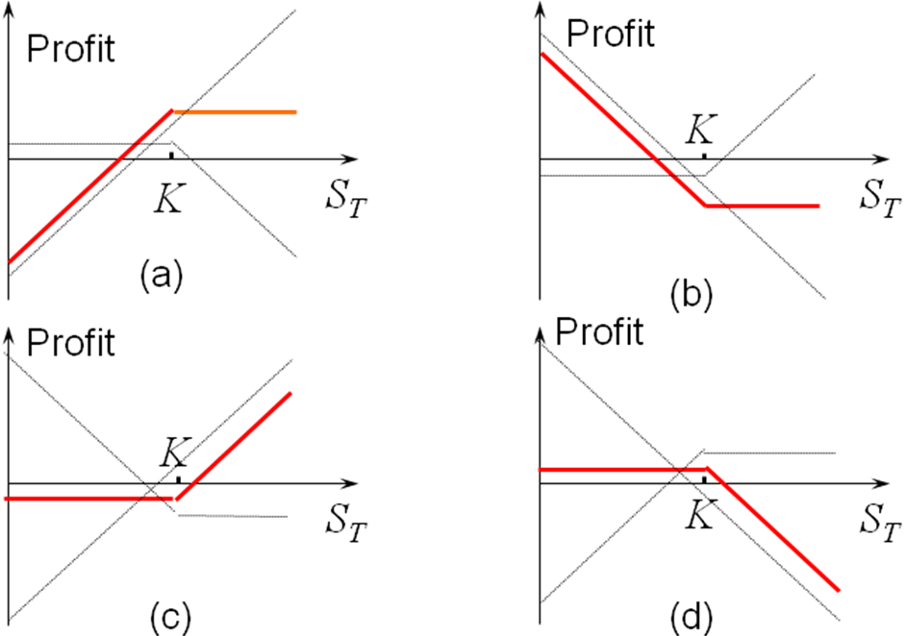
Strategies involving a single option and a stock (b)

Slide 65
Spreads
Involve taking a position in two or more options of the same types (two or more calls, two or more puts).
- Bull Spread
Bear Spread
Butterfly Spread

Slide 66
Bull Spreads
One of the most popular types of spreads.
Created by one of the following two courses:
Course 1 : Buy a call option on a stock with a certain strike price (K1) and sell a call option on the same stock with a higher strike price (K2>K1)
- Course 2 : Buy a put option on a stock with a certain strike price (K1) and sell a put option on the same stock with a higher strike price (K2>K1).

Slide 67
Payoff from course 1:
Stock price range | Payoff from long call | Payoff from short call | Total payoff
S_{T} ≤ K₁ K1< S_{T} ≤ K₂ S_{T}≥K₂ | 0 S_{T}-K₁ S_{T}-K₁ | 0 0 -(S_{T}-K₂) | 0 S_{T}-K₁ K₂-K₁

Slide 68
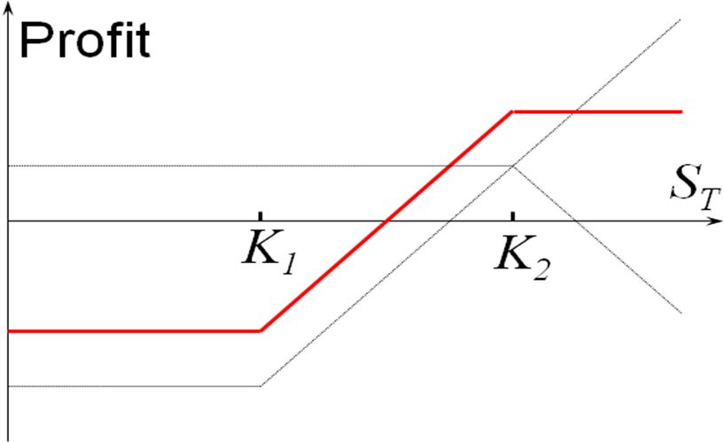
Bull Spreads (two calls)

Slide 69
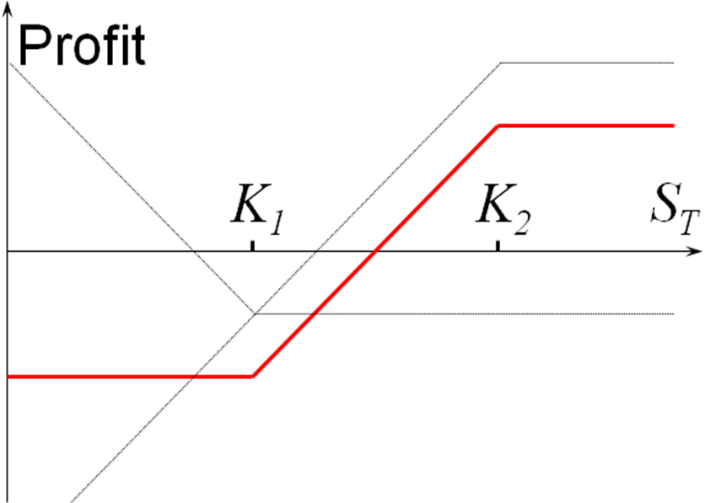
Bull Spreads (two puts)

Slide 70
Ex: Calculate the profit and draw a diagram showing the profit from a bull spread strategy: buy for $3 a call with a strike price of $30 and sell for $1 a call with a strike price of $35.

Slide 71
The profit from the strategy
Stock price range | Profit from long call | Profit from short call | Total profit
S_{T} ≤ 30 30< S_{T} ≤ 35 S_{T} ≥ 35 | -3 S_{T} - 33 S_{T} - 33 | 1 1 -(S_{T}-35)+1 | -2 S_{T} - 32 3

Slide 72
Bear Speads
Course 1 : buy a put on a stock with a certain strike price K2 and sell a put on the same stock with a lower strike price K1 (K1<K2).
Course 2 : buy a call on a stock with a certain strike price K2 and sell a call on the same stock with a lower strike price K1 (K1<K2).

Slide 73
Payoff from the strategy at time T (course 1)
Stock price range | Payoff long put | Payoff from short put | Total payoff
S_{T} ≤ K₁ K1< S_{T} < K₂ S_{T}≥K₂ | K₂-S_{T} K₂-S_{T} 0 | -(K₁ –S_{T}) 0 0 | K₂-K₁ K₂-S_{T} 0

Slide 74
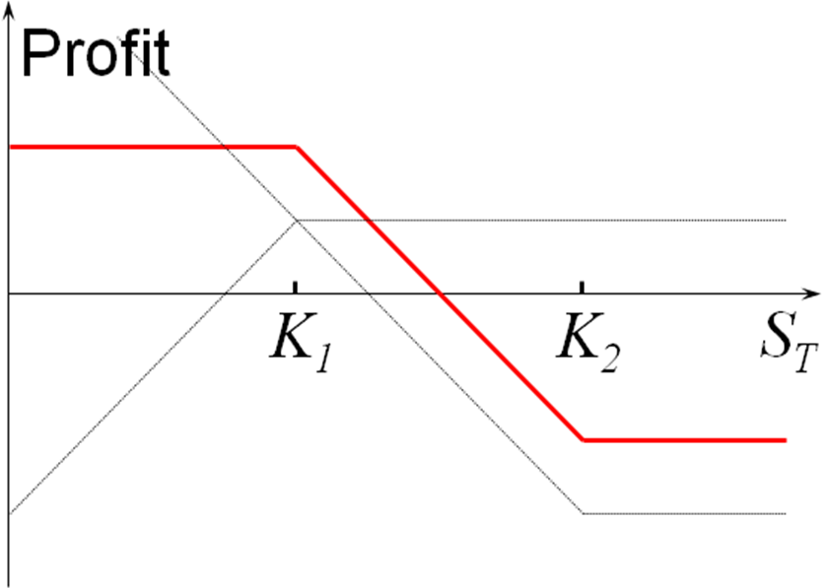
Bear Spread (two puts)

Slide 75
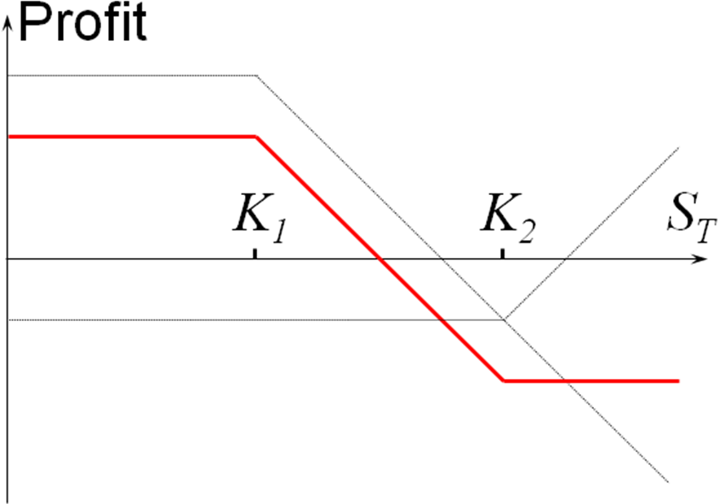
Bear Spread (two calls)

Slide 76
Ex: Calculate the profit and draw a diagram showing the profit from a bear spread strategy: buy for $3 a put with a strike price of $35 and sell for $1 a put with a strike price of $30.

Slide 77
Butterfly Spreads
A butterfly spread involves positions in options with three different strike prices.
Course 1 : buy a call option with a relative low strike price K1, buy a call option with a relative high strike price K3, and sell two call options with a strike price K2, halfway between K1 and K3 (K2=(K1+K3)/2).
Course 2 : buy a put option with a relative low strike price K1, buy a put option with a relative high strike price K3, and sell two put options with a strike price K2, halfway between K1 and K3 (K2=(K1+K3)/2).

Slide 78
Payoff from a butterfly spread (course 1)
K2 = 0.5 (K1 + K3)
Stock price rannge | Payoff from first long call | Payoff from second long call | Payoff from short calls | Total payoff
S_{T} ≤ K₁ K₁< S_{T} < K₂ K₂<S_{T}<K₃ S_{T} ≥ K₃ | 0 S_{T} - K₁ S_{T} - K₁ S_{T} - K₁ | 0 0 0 S_{T} – K₃ | 0 0 -2(S_{T} - K₂) -2(S_{T} - K₂) | 0 S_{T} - K₁ K₃-S_{T} 0

Slide 79
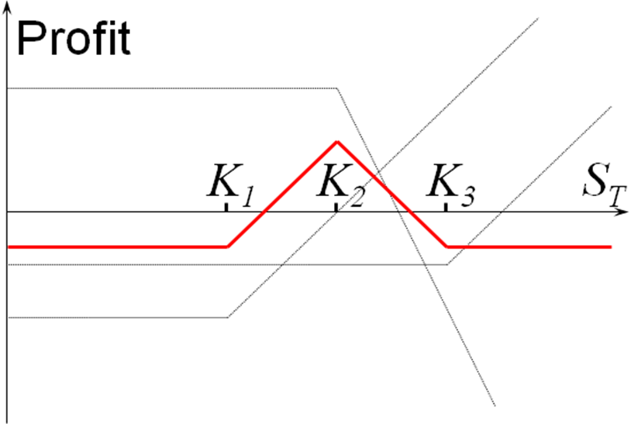
Butterfly Spreads (using calls)

Slide 80
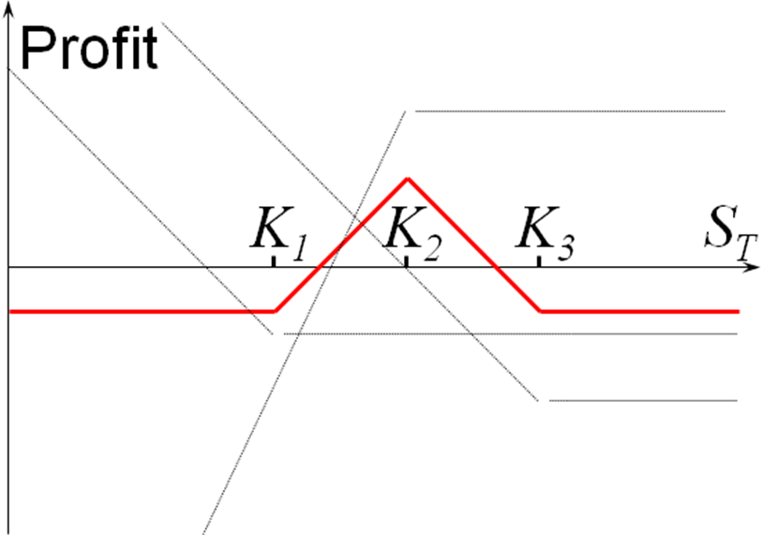
Butterfly Spreads (using puts)

Slide 81
Combinations
Involve taking a position in both calls and puts on the same stock.
Straddle
Strips & Straps
Strangles

Slide 82
Straddle
- Buy a call and a put with the same strike price and expiration date.
Stock price range | Payoff from call | Payoff from put | Total payoff
S_{T} ≤ K S_{T} > K | 0 S_{T} - K | K - S_{T} 0 | K - S_{T} S_{T} - K

Slide 83
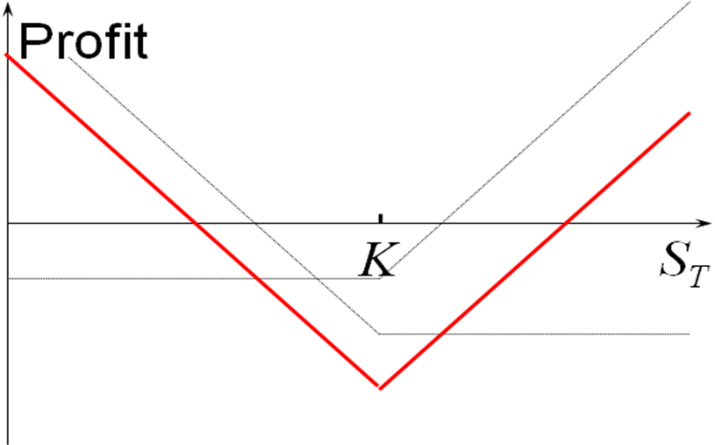
Profit from a Straddle

Slide 84
Strips & Straps
A strip consists of a long position in one call and two puts with the same strike price and expiration date.
A strap consists of a long position in two calls and one put with the same strike price and expiration date.

Slide 85
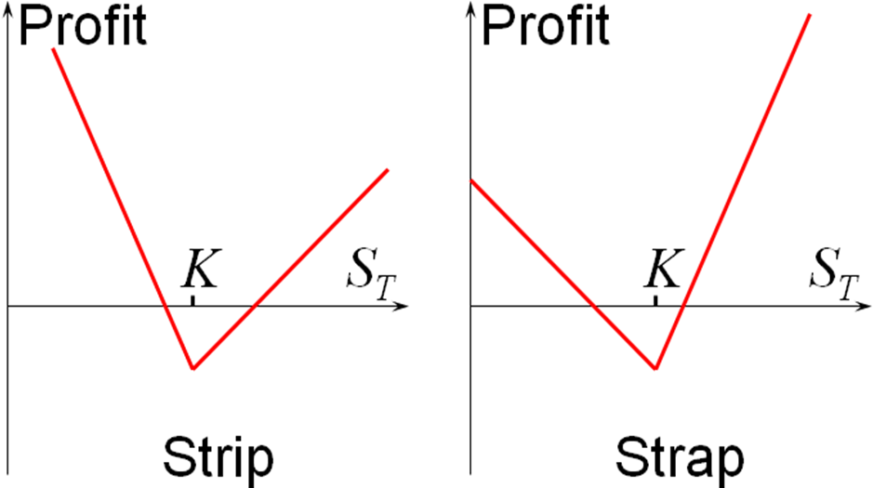
Strips & Straps

Slide 86
Strangles
Sometimes called a bottom vertical combination.
Buy a put and a call with the same expiration date and different strike prices.
Suppose that the strike price of the call, K2 is higher than the strike price of the put, K1:K2 > K1.
Stock price range | Payoff from call | Payoff from put | Total payoff
S_{T} ≤ K₁ K1< S_{T} < K₂ S_{T} ≥ K₂ | 0 0 S_{T}-K₂ | K₁-S_{T} 0 0 | K₁-S_{T} 0 S_{T}-K₂

Slide 87
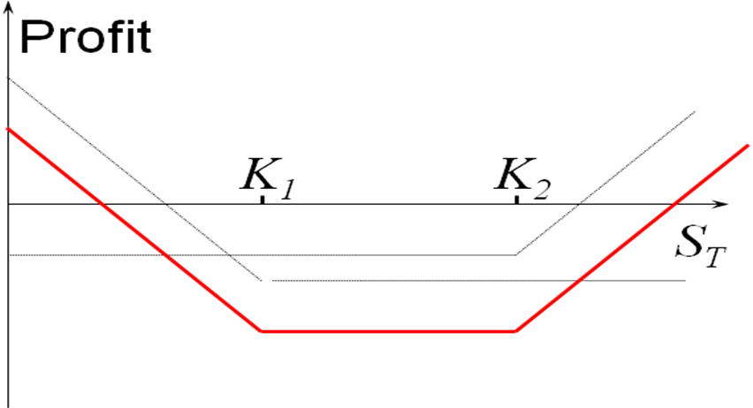
Strangles

Slide 88
Problems
8. A call with a strike price of $60 costs $6. A put with the same strike price and expiration date costs $4. Construct a table and draw a diagram that show the profit from a straddle. For what range of stock price would the straddle lead to a loss?
9. Three put options on a stock have the same expiration date and strike prices of $55, $60 and $65. The market prices are $3, $5 and $8, respectively. Explain how a butterfly can be created. Construct a table and draw a diagram showing the profit from the strategy. For what range of stock price would the butterfly spread lead to a loss?
Notes:
7

